Slide 1

Ping, SAML & Multifactor Authentication Intro
GTTS Software Engineer Training
Jeff Wilson
Software Engineer COE Lead
Date
Released April 2017

Slide 2
SAML Nomenclature
SAML – Security Assertion Markup Language
IDP – Identity Provider (Ping)
SP – Service Provider (Clients – Our Apps)
Identity Store – AD, LDAP, DB
MFA – Multi-Factor Authentication
AuthnRequest – Authentication Request. Request sent to IDP for Authentication.
Assertion – Response from IDP with Authentication Result.
Entity ID – Unique Identifer for an SP
Alias – part of a SAML uri in the SP that denotes a particular client (app)

Slide 3
SAML Basics
SP and IDP Communicate via Signed and/or Encrypted XML Messages
SAML 2.0 Requires connections be made over SSL (HTTPS)
AuthnRequest – XML Message transmitted from SP to IDP to request an authentication. Lets the IDP know which SP is making the request. The request is signed to ensure that it came from an approved SP and that the request was not tampered with in transit.
Assertion – XML Message transmitted from IDP back to SP relating the Authentication Result. Contains a Status, Username(subject) and other attributes configured in the IDP to be returned from the Data Store (email, display name, roles, etc.)

Slide 4




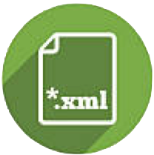
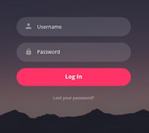
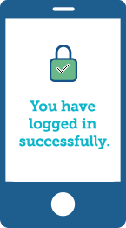
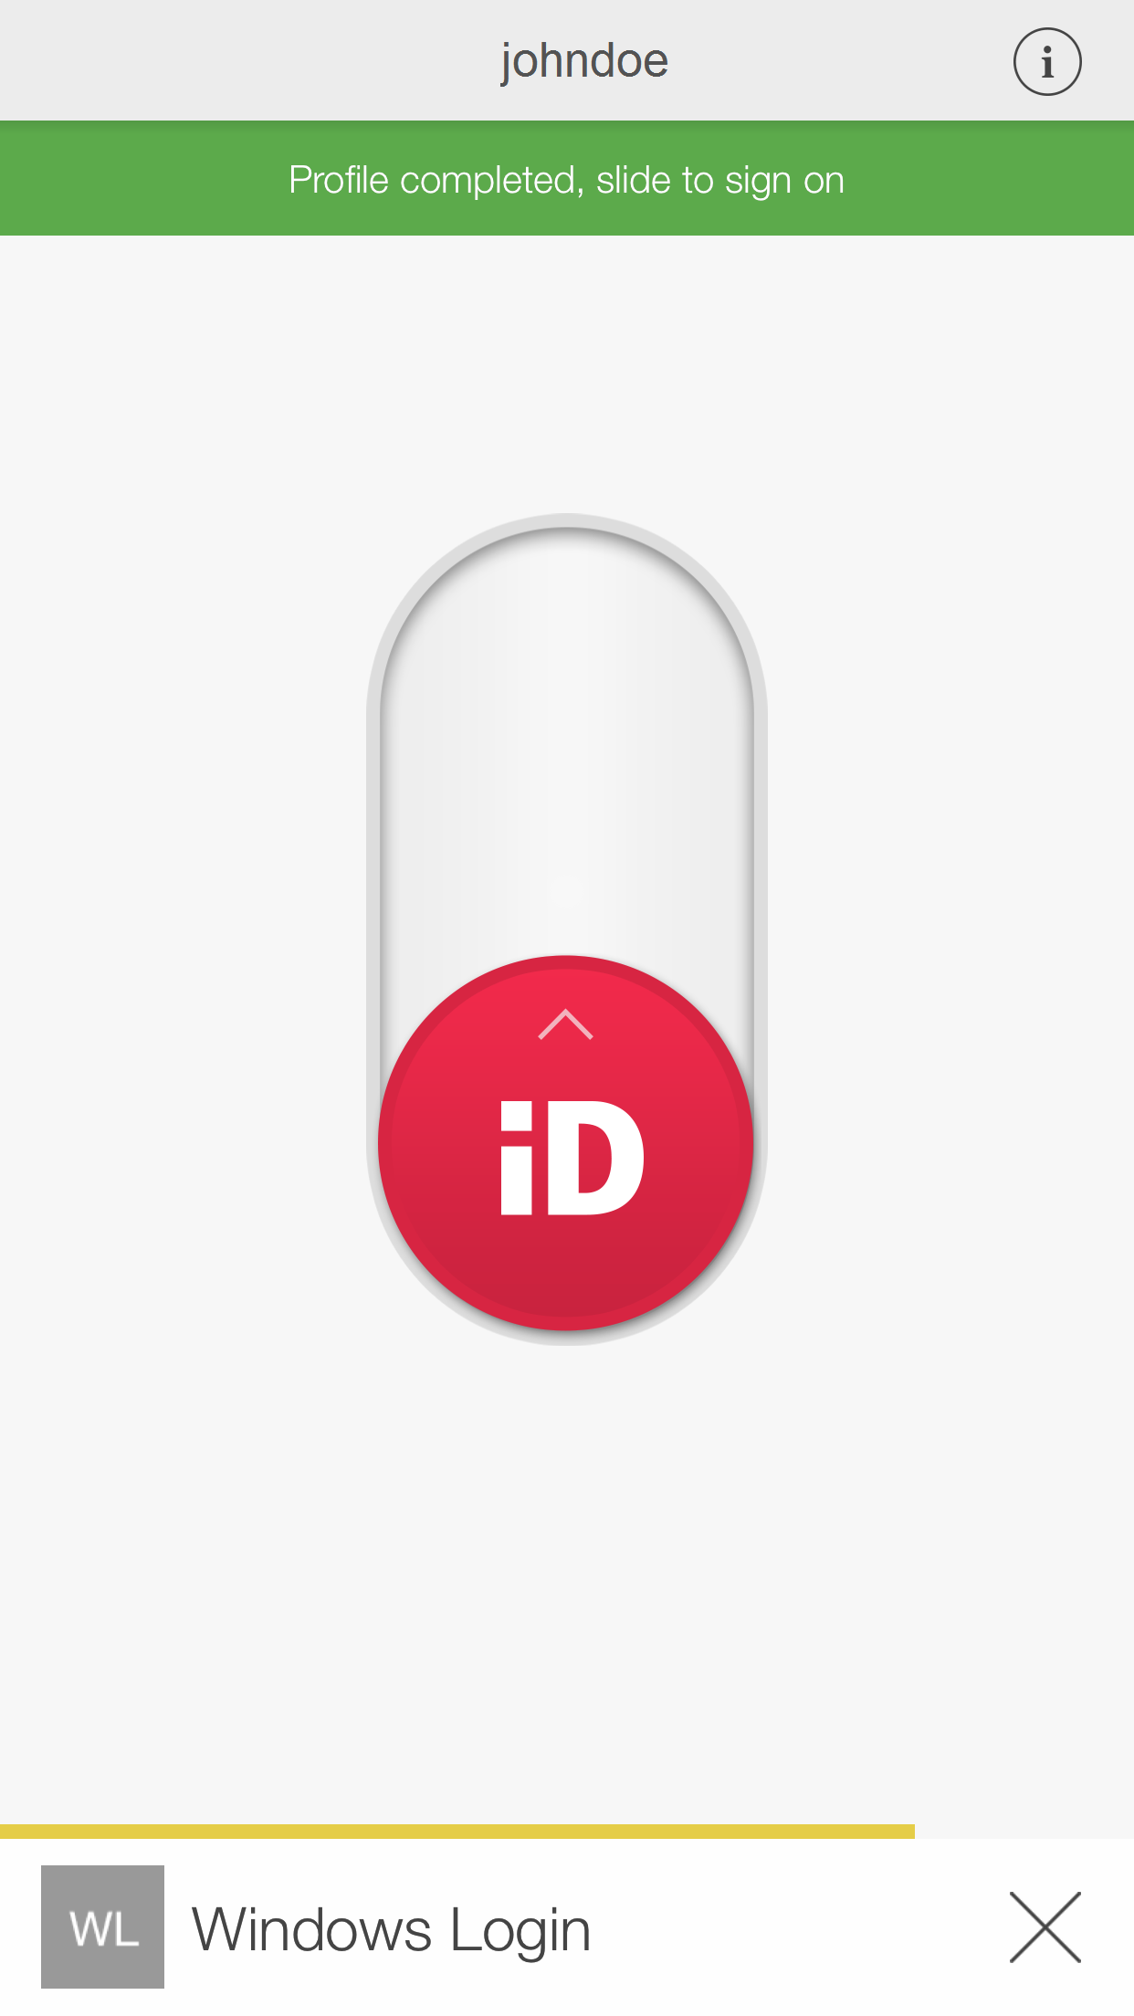

How it works
Service Provider (SP)
Identity Provider (IDP)
SP App requires Authentication
AuthnRequest generated by SP
AuthnRequest sent to IDP
Verify Signature of AuthnRequest
Login Page Displayed
Credentials Sent to Identity Store
Identity Store Verifies Credentials
Sends Response back to IDP
IDP Invokes 2nd Factor
IDP Generates Assertion
IDP Sends Assertion to SP
SP Verifies Assertion
SP Sets User Attributes and proceeds into Application
Identity Store

Slide 5
SP Artifacts
Keypair in jks format for signing AuthnRequests
SP xml file that resides on SP host and is used in the IDP tool to populate an SP Connection Entry
IDP xml file that resides on the SP Host and is generated in the IDP. Contains the IDP urls and public key from the IDP keypair for verifying Assertions from the IDP

Slide 6
GTTS SSO Identity Provider
PingIdentity
PingFederate
PingAccess
PingOne
Application Conversion to leverage PingIdentity
SAML Compliance
HTTP Header Compliance
WS_TRUST

Slide 7

GTTS will leverage the PingIdentity suite of applications for Identity Federation, Single Sign-On (SSO) Authentication
GTTS will leverage the Corporate Licensing structure for Ping Identity
PingIdentity Suite
PingFederate
PingAccess
PingOne

Slide 8

Will serve as the Identity Provider for GTTS.
Provides Identity Federation across multiple Identity Stores
GGSG-US AD
CEC
DSX
PingFederate supports Single Factor (SFA) & Multi-Factor(MFA) Authentication
Supports WS-TRUST which may be leveraged in a later phase to replace the current Java Web Token strategy for Rest API solutions (i.e. ICRS API)

Slide 9

Provides Support for Applications that cannot directly leverage PingFederate for Authentication.
Applications that do not support SAML
Leverages HTTP headers to instantiate authenticated user session
Leverages PingFederate to perform the actual authentication
Uses Oauth to connect to PingFederate
Plays the role of SAML Client in front of Ping Federate and communicates the Authentication results to the Service Provider via an HTTP Header

Slide 10

Provides an Alternative Authentication Factor utilizing an independent one-time token based authentication
Will be a primary Second Factor for the GTTS Multi-Factor Authentication Solution
Offers multiple device interfaces to leverage the one time token
Mobile Application
SMS Token Delivery
Voice Token Delivery
Email Token Delivery
PC/Mac Desktop Application
Yubikey

Slide 11
Application Conversion
Determining which Solution to leverage for an Application
Grails 3 Applications
Legacy Applications
3rd Party Applications

Slide 12
Solution Decision Chart
Native SAML Compliant
SAML Compliant With Modification
Native Set Auth User with Header
Set Auth User in Header With Modification
Alternative Solution

Slide 13
Grails 3 Applications
Grails 3 apps are compliant due to the addition of the gtts-g3-saml plugin.
Instructions on how to setup a Grails 3 Application for SAML can be found in the Ping Identity & SAML section on the Software Engineer COE Portal Page

Slide 14
Legacy Applications
Legacy Applications (GCI) are still being studied for how they will interface with the PingIdentity suite
Ping Federate with Direct Tomcat SAML Interface using tool like Picket Link
Requires an additional tool set that may incur additional cost.
Ping Access with HTTP Header interface
Requires Tomcat configuration changes that may involve writing custom filters

Slide 15
3rd Party Applications
3rd Party Applications will be taken on a case by case basis to determine which methodology will be utilized
May require additional plugins
Some may not be compliant at all

